Slide 1

Machine Learning for Breast Cancer Diagnosis: A Data-Driven Approach
Enhancing diagnosis with data-driven methods
Jonghun Park
Xiao Zhong
Tang Yip

Slide 2
Agenda
Breast Cancer
Statistics in Australia
Screening and Early Diagnosis
Motivation
Breast Cancer Dataset
Cleansing
Normalisation
X = Diagnosis’ features; y = diagnosis
Feature Engineering
Distribution after Scaling
Boxplot
Pairplot
Heatmap
Feature Selection
Principal Component Analysis (PCA)
Machine Learning Algorithms
LR, SVM, RF, and KNN
Cross Validation
Evaluation
Ensemble method
Final Training
Model Training and Validation
Model Training, Hyperparameter Tunning, Testing
Deployment and Monitoring
Community Resource Optimization

Slide 3

Breast Cancer Statistics in Australia
Breast cancer is the most common cancer among women in Australia (excluding non-melanoma skin cancer) and the second leading cause of cancer-related deaths after lung cancer. In 2024, an estimated 20,973 people were diagnosed, with the average age at diagnosis being 62.
By age 85, one in eight females and one in 667 males in Australia are expected to be diagnosed with breast cancer. Participation in national cancer screening programs reduces mortality risk by 54%-63%. In 2020, breast cancer was the most diagnosed cancer in the country.
Breast Screen Australia (BSA) plays a crucial role, with over 1.8 million women aged 50-74 screened in 2018–2019. Since the program’s inception, mortality rates have significantly declined from 74 deaths per 100,000 women in 1991 to 40 per 100,000 in 2018. However, disparities persist, with bisexual women and gay men facing twice the cancer risk due to higher smoking and alcohol consumption rates and lower screening participation.
Early detection through effective screening is crucial for improving survival outcomes in breast cancer cases.

Slide 4
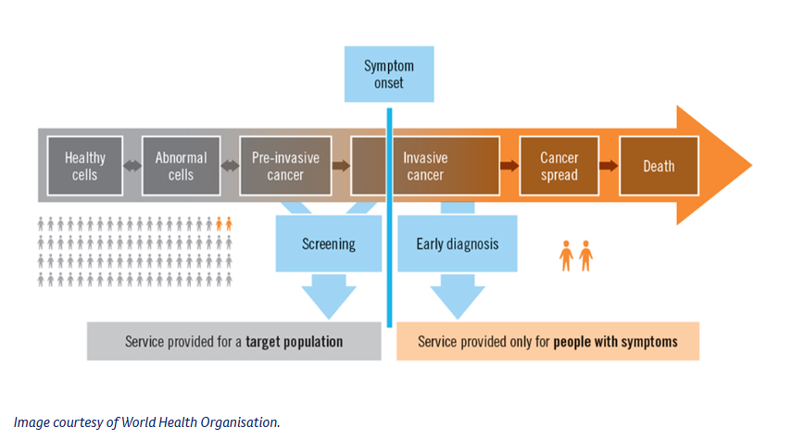
Screening and Early Diagnosis
Breast cancer screening
Increase participation rate of breast cancer screening rate to at least 65% by 2025.
After a diagnosisMachine learning models lead to improve accuracy in diagnoses, ensuring patients receive the correct treatment or follow up
Early detection
Screening survival rates.

Slide 5
Motivation
Increasing Participation:
Aim to raise the breast cancer screening rate to at least 65% by 2025.
After Diagnosis:
With improved diagnostic accuracy, ensure patients receive appropriate treatment or follow-ups while optimizing resource allocation across communities.
Early Detection:
Enhanced screening programs and more accurate diagnoses contribute to early breast cancer detection, leading to better treatment outcomes and higher survival rates.

Slide 6
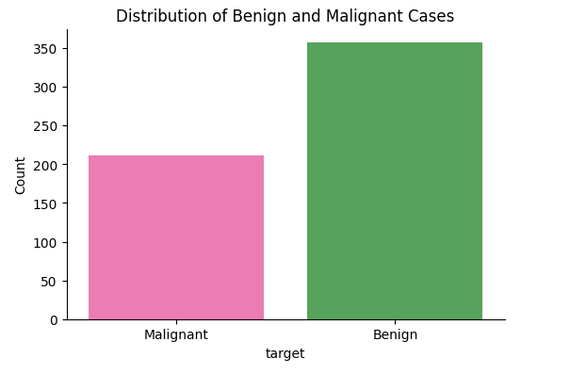
Breast Cancer Dataset
Breast Cancer Dataset
Benign: 357; Malignant: 212
Data Cleansing
Drop columns in "id", "Unnamed: 32"
Data Normalization: using StandardScaler
X = Diagnosis’ features; y = diagnosis

Slide 7
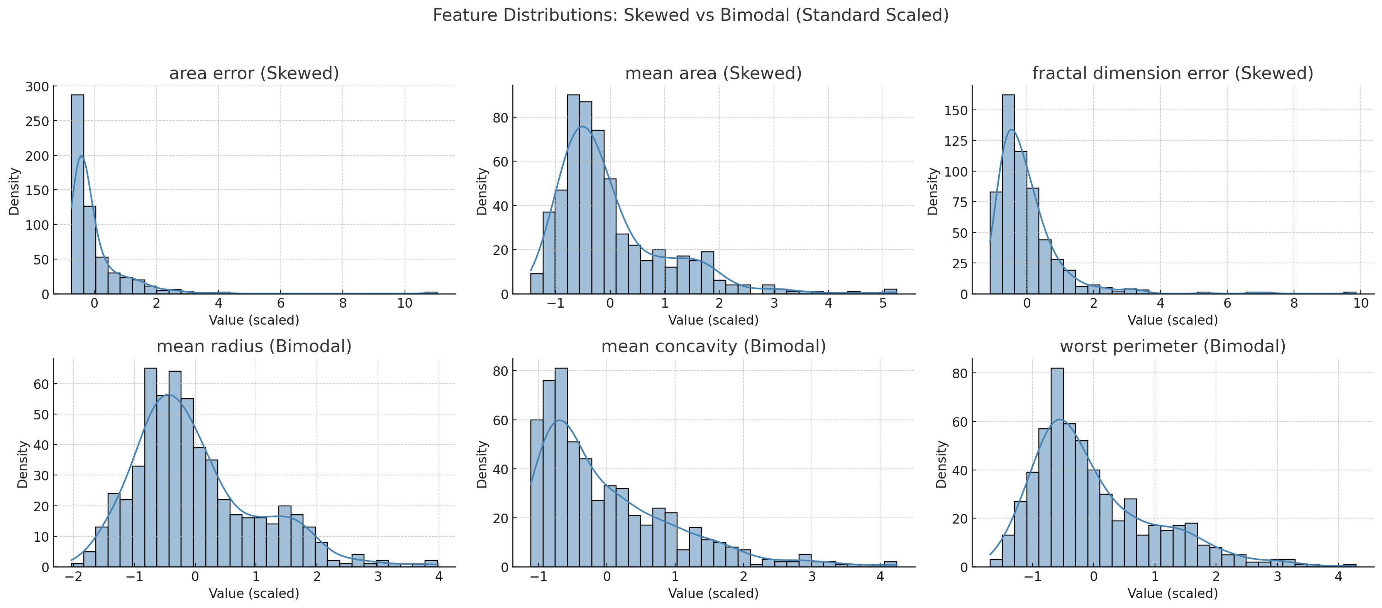
Features Engineering
Notes:
Why We Scale the Data
“We apply Standard Scaling to ensure that all features contribute equally to machine learning models. It adjusts each feature to have a mean of 0 and a standard deviation of 1.”
Some features (like “area” or “radius”) have larger numerical ranges.
Algorithms like KNN, SVM, logistic regression, and PCA are sensitive to feature scale.
Interpreting the Distribution Plots
“After scaling, we plotted the distribution of each feature. This helps us understand the shape of the data, spot outliers, and detect skewness or multi-modal behavior.”
What to highlight from the plot:
Most features are roughly bell-shaped (normal distribution), especially after scaling.
Some features may still show skewness (e.g., positive or negative tails).
There are a few features that appear bimodal—which may reflect differences between malignant and benign classes.
"Even after scaling, some features still show interesting distribution patterns. This might suggest that they are highly discriminative between cancerous and non-cancerous cases."
“Understanding the distribution of features gives us intuition about which variables might be more informative. For instance, features with more variation or bimodality can be great predictors.”
Skewed features might still show long tails → these may need further transformation (like log scaling).
Bimodal features might be very informative for classification — they're showing clear differences between the two tumor types!

Slide 8
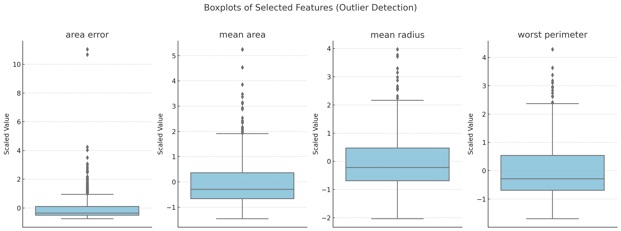
Boxplot
Notes:
A boxplot (a.k.a. box-and-whisker plot) summarizes the distribution of a dataset and highlights potential outliers.
"The dots beyond the whiskers are statistical outliers. In medical data, these could represent tumors with significantly larger size or unusual properties. While they might be true values, it’s essential to consider them carefully—they could skew the model or contain important clinical insights."
Keep them: if they’re valid and meaningful (e.g., aggressive tumors).
Transform: to reduce their impact (e.g., use log-scaling).
Remove: only if they are likely errors or extremely rare cases.

Slide 9
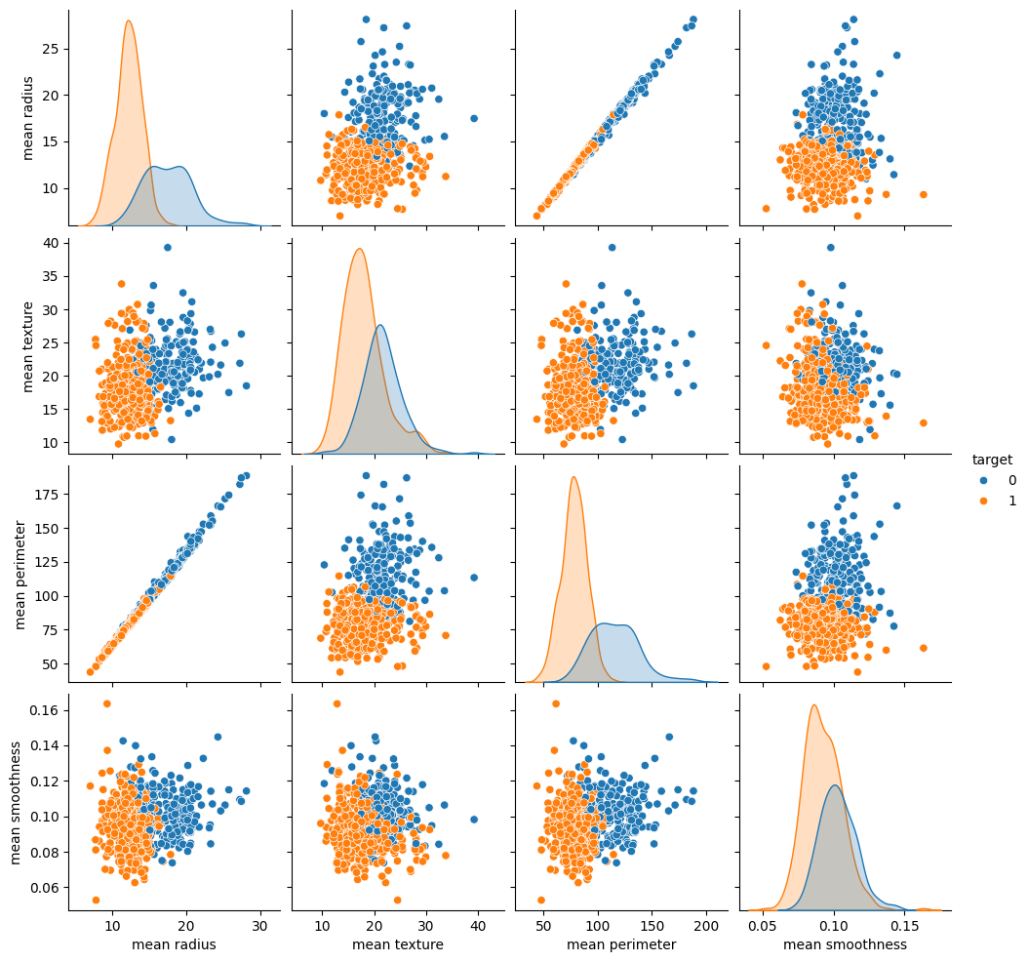
Pairplot
Notes:
The pairplot shows pairwise scatter plots for different features, with the points color-coded by whether the tumor is benign or malignant.
"Before applying any machine learning models, it's important to understand the relationships between features. One powerful way to do that is using a pairplot. It helps us see patterns, correlations, and potential for separating classes."
"This is a pairplot showing selected features from the breast cancer dataset. Each point represents a sample. The diagonal shows the distribution of individual features, while the off-diagonals show scatterplots between two features, colored by class (benign or malignant)."
Class Separation
"We can observe that some feature pairs show clear separation between classes. For example, mean radius vs. mean texture shows two distinct clusters. This tells us that these features are useful for classification."
Correlated Features
"Some scatterplots show a strong linear trend, like mean area and mean radius. This suggests they’re highly correlated. We might consider removing one to reduce redundancy or applying dimensionality reduction techniques like PCA."
This visual insight helps guide feature selection. We can choose features that best separate the classes and drop or transform features that are highly correlated or skewed. This can improve model performance and reduce overfitting."
"I’ve selected these four features from the dataset: mean radius, mean texture, mean perimeter, and mean smoothness. These were chosen to highlight class separation and correlation patterns. For instance, we can see that mean radius and mean perimeter are strongly correlated, which is common since larger tumors tend to have larger perimeters."
"Notice how malignant and benign cases often cluster separately, especially along the mean radius and mean texture axes. That tells us these features will be valuable for classification."

Slide 10
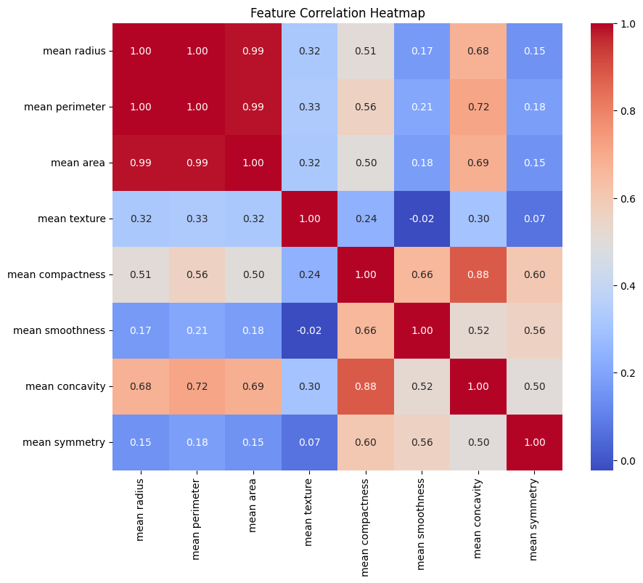
Feature Correlation Heatmap
Identify patterns, correlations, and trends.
Higher and lower values are visually distinguished using different shades or colours.
Notes:
"A heatmap is a visual representation of the correlation matrix. Each cell shows the correlation coefficient between a pair of features, ranging from -1 to 1. A value close to 1 means strong positive correlation, -1 means strong negative correlation, and 0 means no correlation."
"We use a heatmap to quickly identify highly correlated features. If two features are strongly correlated, they might provide redundant information to the model. This can lead to overfitting or unnecessarily complex models."
"In this heatmap, we can see that mean radius, mean perimeter, and mean area are very highly correlated — the values are close to 1. That makes sense — larger tumors tend to have bigger radius, perimeter, and area. So, instead of keeping all three, we might choose one or apply dimensionality reduction like PCA."
"We can also spot some features with low or negative correlation to others, which could add unique information to the model."
"By identifying these relationships visually, we can make smarter choices about which features to keep, combine, or drop."

Slide 11
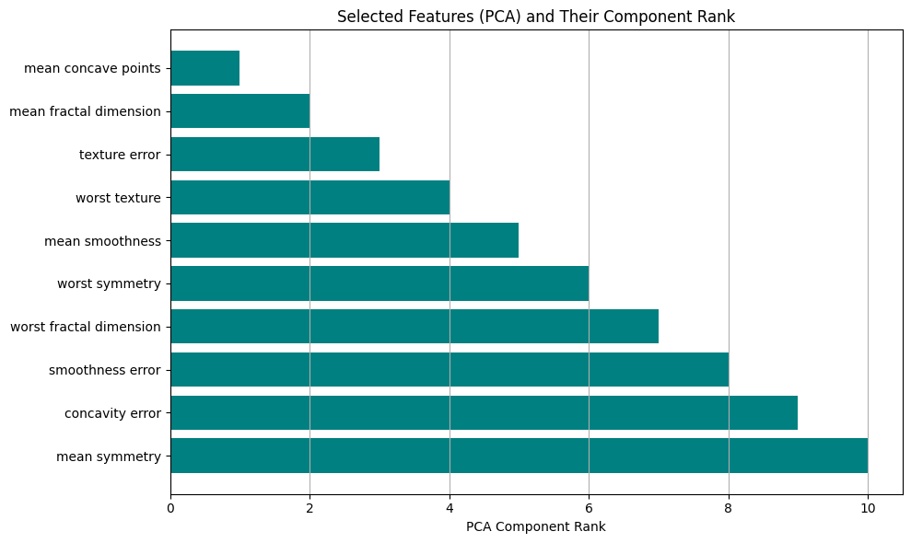
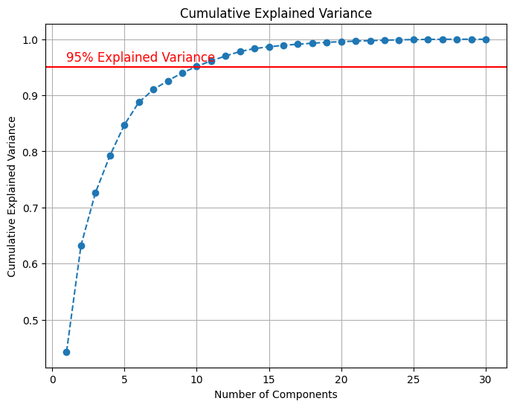
Features Selection Principal Component Analysis (PCA)
Notes:
"Principal Component Analysis, or PCA, is a technique used to reduce the number of features while preserving as much variance (or information) in the data as possible. It transforms the original features into new, uncorrelated components called principal components."
"In datasets like the breast cancer dataset, many features are correlated, which means they provide overlapping information. PCA helps us combine these correlated features into fewer components that still capture most of the data’s structure. This makes models faster, simpler, and often more accurate."
Cumulative Explained Variance: Each principal component explains a portion of the total variance in the data. The cumulative explained variance is the sum of the variance explained by each component up to a certain point.
To achieve 95% cumulative explained variance, you select the minimum number of principal components needed such that their combined explained variance is at least 95%. These selected components represent the most important information in the data.
Features explaining 95% variance: ['mean concave points', 'mean fractal dimension', 'texture error', 'worst texture', 'mean smoothness', 'worst symmetry', 'worst fractal dimension', 'smoothness error', 'concavity error', 'mean symmetry']
Selected Features (emphasizing recall): ['mean concave points', 'mean fractal dimension', 'texture error', 'worst texture', 'mean smoothness', 'worst symmetry', 'worst fractal dimension', 'smoothness error', 'concavity error', 'mean symmetry']
The goal is to reduce features without losing too much valuable information. Aiming for 95% cumulative explained variance ensures that the reduced dataset still represents the original data well.

Slide 12
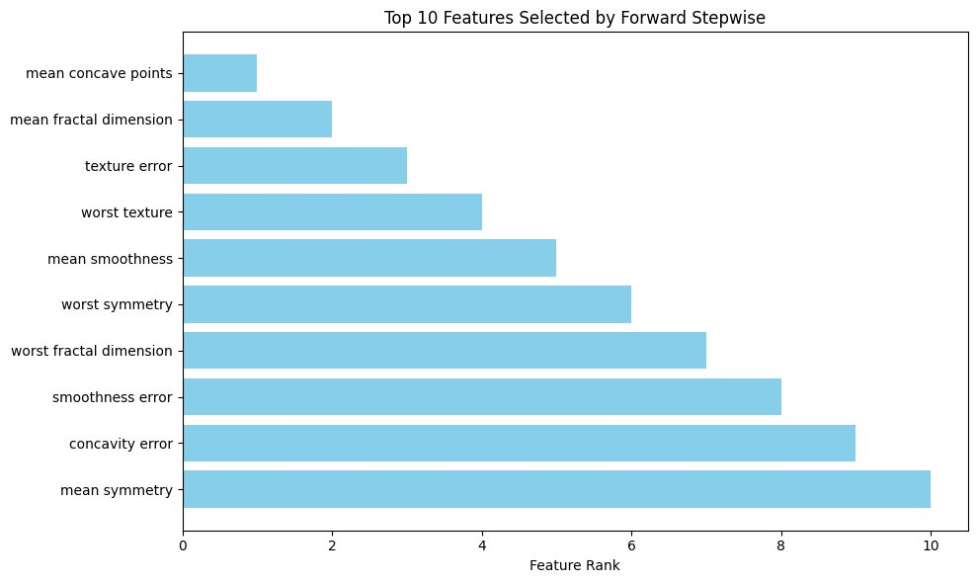
Features Selection (Forward Stepwise)
Notes:
SFS is a greedy search algorithm that selects a subset of features by iteratively adding or removing features based on their performance in a model.
Here, I used forward selection, which starts with no features and adds one at a time based on their contribution to model performance.
SFS is a simple yet effective technique for selecting the best subset of features, especially when the feature space is large, and you want to avoid overfitting by using only the most important features.
Selected Features: [np.str_('mean concavity'), np.str_('mean fractal dimension'), np.str_('texture error'), np.str_('smoothness error'), np.str_('symmetry error'), np.str_('worst texture'), np.str_('worst area'), np.str_('worst smoothness'), np.str_('worst compactness'), np.str_('worst concavity')]
The goal is to reduce features without losing too much valuable information. Aiming for 95% cumulative explained variance ensures that the reduced dataset still represents the original data well.

Slide 13
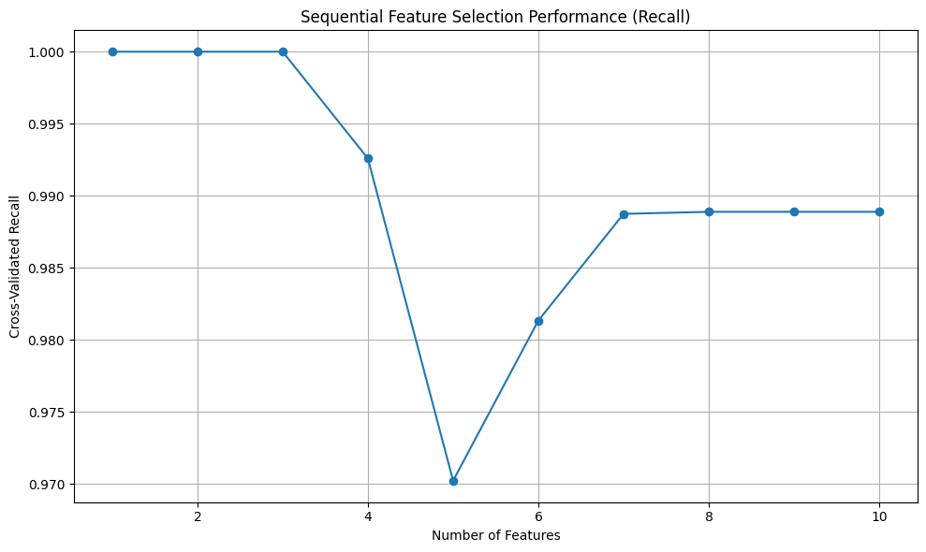
Cross Validation
Notes:
For recall optimization, SFS is likely to perform better since it is tailored for selecting features that maximize recall, whereas PCA + RFE might lose some important details by focusing on components rather than individual features.
As you can see from the output, the highest mean recall score (approximately 0.976) was achieved when using a cross-validation fold of 3.
While cv=3 gives a perfect recall score, you should consider the stability and generalisation ability of the model. A slight drop in recall from cv=3 to cv=5 or cv=10 (which is still very high) suggests that the model is more robust with more folds.
cv=5 and cv=10 should be preferred for most use cases, especially in real-world applications, because they provide more stable results and reduce the likelihood of overfitting.
cv=5 or cv=10 would likely be better choices for final model selection, as they provide more reliable estimates of the model's performance on unseen data. cv=3 could be used as a quick test, but it shouldn't be relied on for selecting the final model.

Slide 14
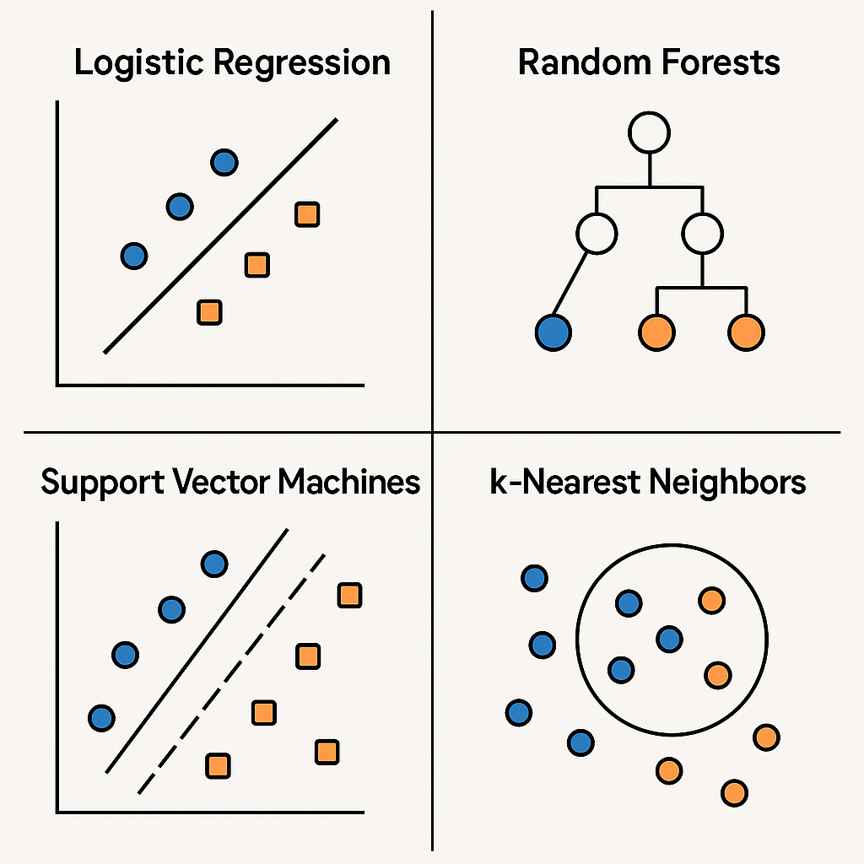
LR, RF, SVM and KNN
Logistic Regression – A classification algorithm that predicts probabilities and assigns data points to binary categories (e.g., yes/no) using a sigmoid function.
Random Forests – An ensemble learning method that builds multiple decision trees and combines their outputs to improve accuracy and reduce overfitting.
Support Vector Machines (SVM) – A classification algorithm that finds the best boundary (hyperplane) to separate different classes with the largest margin.
K-Nearest Neighbors (KNN) – A classification and regression algorithm that assigns a label to a new data point based on the majority class of its nearest neighbors.

Slide 15
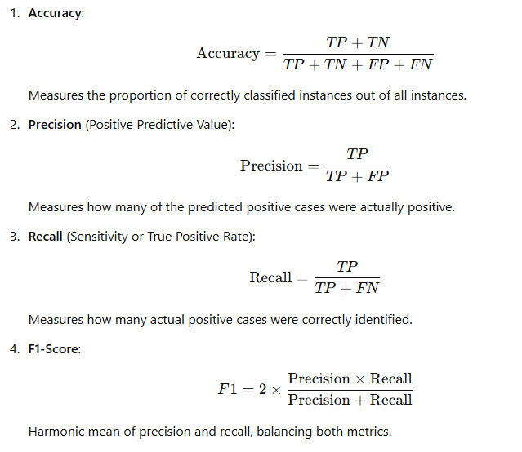
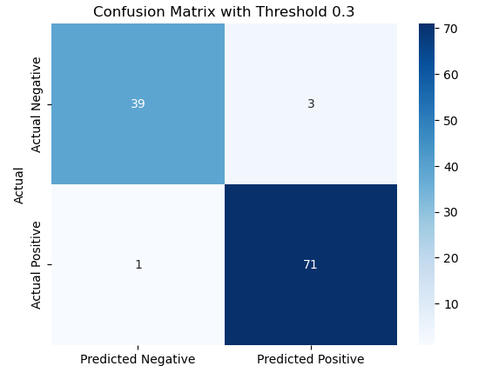
Evaluation

Slide 16
Ensemble Methods
Boosting
Boosting focuses on improving weak models by combining them sequentially. Each model attempts to correct the errors of the previous one.
It aims to reduce bias and is effective when models are weak learners (e.g., shallow decision trees).
Boosting may overfit if the base learners are too complex.
Bagging
Bagging reduces variance by training models independently using bootstrapped subsets of the data and then averaging their predictions.
It works well with high-variance models (e.g., deep decision trees) and helps prevent overfitting.
Bagging does not focus on the sequential dependency between models.

Slide 17
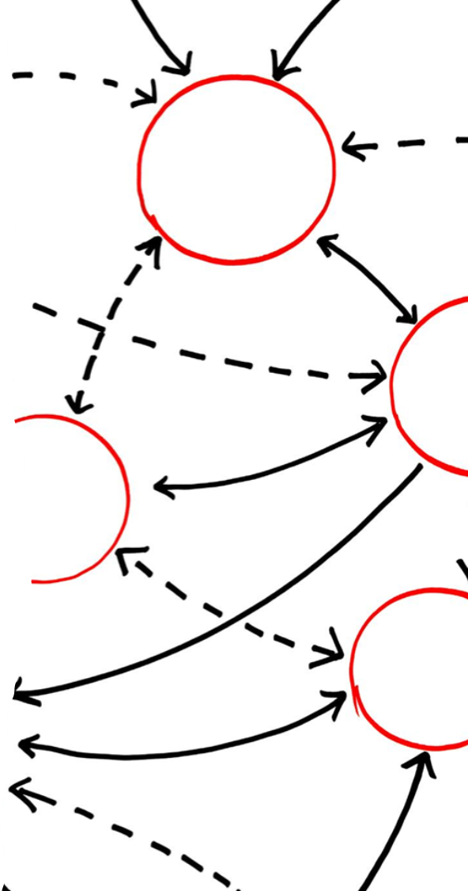
Model Training, Hyperparameter Tunning, Testing
Model Training - using training data to fit the model by adjusting parameters.
Hyperparameter Tunning – Optimizing model settings to improve performance.
Testing (model Evaluation) – assessing the trained model on a separate test dataset
Compare model performances across specific metric in Accuracy, Precision, Recall, and F1-Scor.
Highlight strengths and weaknesses of various models for better decision-making.
Identifying the best model .

Slide 18
Deployment and Monitoring
Develop a user-friendly interface for medical professionals to use the model effectively.
1
Monitor the model's performance in real-world settings and update it as needed.
2
Ensure compliance with ethical standards and data privacy regulations.
3

Slide 19
Community Resource Optimization
Use predictive analytics to allocate resources efficiently, such as prioritizing high-risk patients for follow-ups.
Implement the model in underserved communities to improve access to early diagnosis.

